Slide 1
ZeroER: Entity Resolution using Zero Labeled Examples
Renzhi Wu*, Sanya Chaba*, Saurabh Sawlani*, Xu Chu*
Saravanan Thirumuruganathan⁺
*Georgia Institute of Technology
⁺ Qatar Computing Research Institute (QCRI)

Slide 2
Entity resolution
Table A
Table B
Supervised ML
Huge labeling effort
Can be done with less effort using tools such as Magellan
Similarity
feature
generation
a1
a2
a3
…
b1
b2
b3
…
(a1,b1)
(a1,b2)
(a3,b2)
…
(0.18,0.64,0.29,…)
(0.69,0.95,0.99,…)
(0.11,0.13,0.01,…)
…
(a1,b1) | U
(a1,b2) | M
(a3,b2) | U
… | …
Blocking
Matching
Ⅹ
Table A
Table B
Tuple pairs
Similarity vectors
Match or Unmatch

Slide 3
The need for ZeroER
State-of-the-art: supervised ML, deep learning, e.g. DeepMatcher [Mudgal, 2018]
Limitation: require many labeled examples
Our goal: Perform ER using zero labeled examples while achieving comparable performance to supervised ML approaches
Q1. How distinguish matches from unmatches without labels?
Q2. How to ensure good performance?

Slide 4
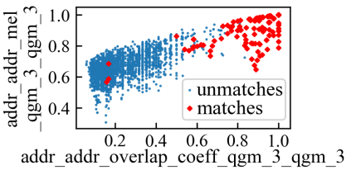
Generative Modelling
Q1. How distinguish matches from unmatches without labels?
Observation: the similarity vectors for matches $X_{M}$ should look different from the similarity vectors for unmatches $X_{U}$
$X_{M} \sim$M-distribution
$X_{U} \sim$U-distribution
M-distribution $=$ Gaussian($μ_{M}$, $Σ_{M}$)
U-distribution $=$ Gaussian($μ_{U}$, $Σ_{U}$)
Gaussian mixture model (GMM)
Expectation maximization (EM) algorithm

Slide 5
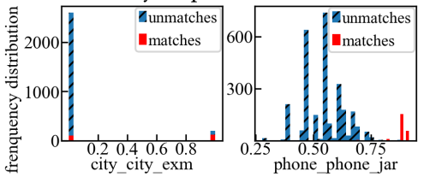
Challenges
Q2. How to ensure good performance?
Challenge 1: Data deficiency in Matching pairs
#matches < #parameters in M distribution
Challenge 2: Degenerated Features
Challenge 3: Incorporating Transitivity
b1
b1
a1
b2
b2

Slide 6
Challenge 1: Data deficiency in Matching pairs
Number of matches < number of parameters in M distribution
fodors-
zagats
112 matches
68 features (Magellan) 2346 parameters in $μ_{M}$and $Σ_{M}$
How to reduce the number of parameters?
The two most common approaches (provided in sklearn):
Assume feature independence, i.e. $Σ_{M}$ and $Σ_{U}$ are diagonal
Assume covariance can be shared, i.e. $Σ_{M}=Σ_{U}$

Slide 7
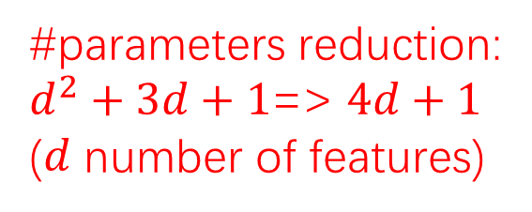
Feature grouping & correlation sharing
feature independence
feature grouping:
features generated from the same attribute are dependent
features generated by different attributes are independent.
Sharing covariance matrix $Σ_{M}=Σ_{U}$
Sharing correlation matrix $R_{M}= R_{U}$
the Pearson correlation matrices $R_{M}$ and $R_{U}$ reflect correlation between similarity functions
$Σ_{M}=Λ_{M}R_{M}Λ_{M}$ $Σ_{U}=Λ_{U}R_{U}Λ_{U}$
#parameters reduction:
$d^{2}+3d+1$=> $4d+1$
($d$ number of features)

Slide 8
Challenge 2: Degenerated features
degenerated feature $f_{1}$
normal feature $f_{2}$
Feature overfitting: degenerated features with extremely small variances dominate prediction
Increase variances of features with regularization:
Data likelihood
Regularization
Solution of maximizing the above objective:
Sample cov matrix
Regularization parameter (amount of variance increase)

Slide 9
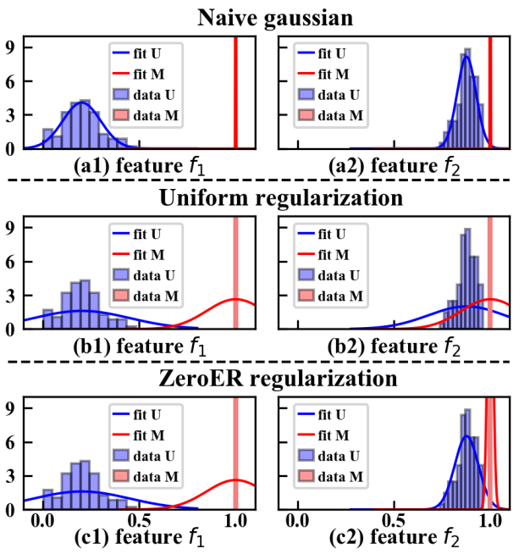
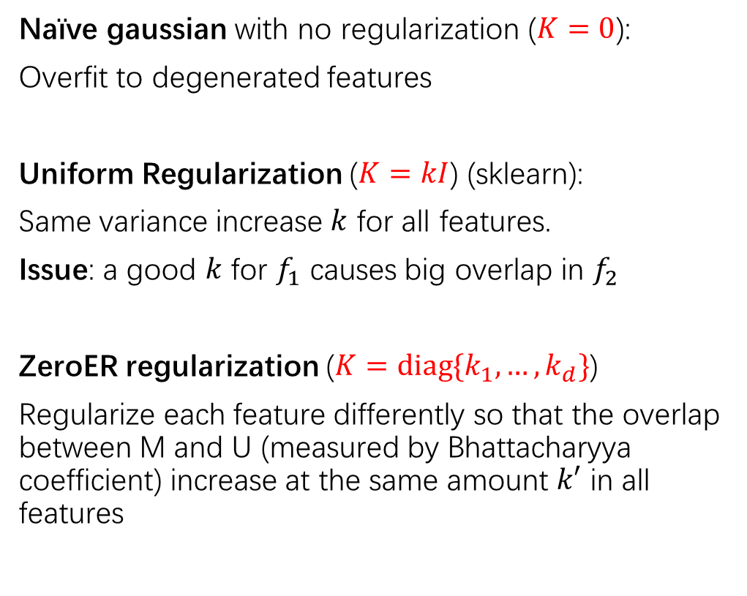
Feature regularization
A good $K$ should
(1) fatten the “spiky” distribution (to resolve feature overfitting)
(2) Not cause too much overlap between M and U (not hurt the predictive power of a feature)
Sample cov matrix
Regularization parameter
Naïve gaussian with no regularization ($K=0$):
Overfit to degenerated features
Uniform Regularization ($K=kI$) (sklearn):
Same variance increase $k$ for all features.
Issue: a good $k$ for $f_{1}$ causes big overlap in $f_{2}$
ZeroER regularization ($K=diag\{k_{1},…,k_{d}\}$)
Regularize each feature differently so that the overlap between M and U (measured by Bhattacharyya coefficient) increase at the same amount $k′$ in all features

Slide 10
Challenge 3: Incorporating Transitivity
b1
b1
a1
b2
b2
Transitivity is typically done in a post-processing step
We incorporate transitivity directly during model learning
We express transitivity as inequality of probabilities:
$$p_{M}\left(a_{1},b_{1}\right)×p_{M}\left(a_{1},b_{2}\right)<p_{M}(b_{1},b_{2})$$
$\left({n \atop 3}\right)$ inequalities in total

Slide 11
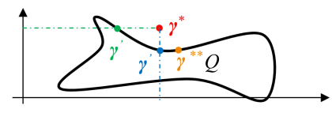
Transitivity as posterior constraint in EM
$γ$: vector of matching probabilities of all tuple pairs
In EM, $γ$ is computed via the Bayes rule.
How to incorporate $Q$?
The Free energy view of EM
E step:
M step:
Posterior
constraint
Non-convex optimization
2. $\left({n \atop 3}\right)$ constraints in $Q$
Projection
Relaxation

Slide 12
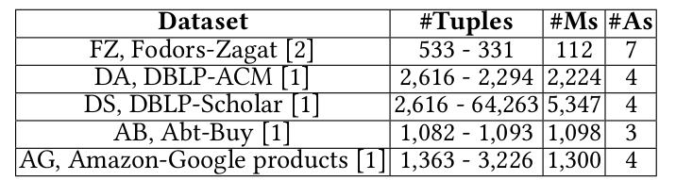
Experiments: setup
Five datasets
Unsupervised | Supervised | Active learning
Logistic Regression (LR) Random Forest (RF) Multilayer Perceptron (MLP) DeepMatcher (DM) | K-Means (KM-SK) K-Means (KM-RL) GMM ECM PPjoin | Active learning based Random forest (AL-RF)
Ten baselines
Blocking: blocking on the most informative attribute using Magellan
Features: automatically generated using Magellan

Slide 13
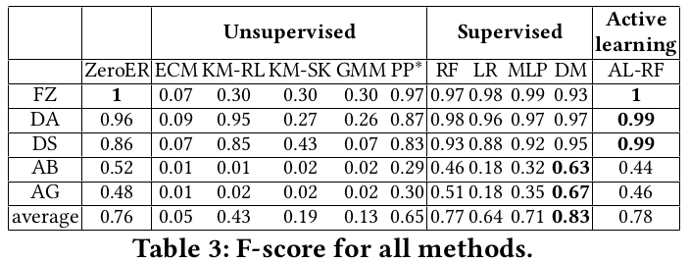
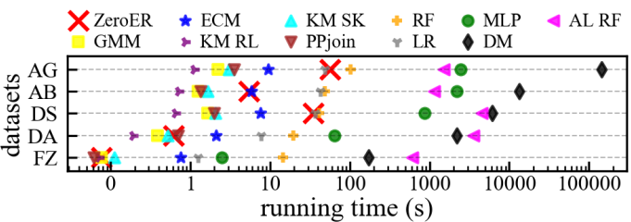
Experiments: performance
F1 score

Slide 14
Experiments: labeling effort saved

Slide 15
Conclusion & future work
ZeroER
Automatic Blocking
Automatic feature engineering

